Slide 1
DOE Technical Assistance Program
Designing Effective
Residential Retrofit Programs
Richard Faesy
Energy Futures Group
DOE Technical Assistance Program
Team 4 – Program & Project Development & Implementation
August 30, 2010

Slide 2
Webinar Overview
Technical Assistance Project (TAP) Overview
Part 1: Retrofit Program Design Elements
Part 2: Steps in Developing a Retrofit Program
Resources
Q&A

Slide 3

What is TAP?
DOE’s Technical Assistance Program (TAP) supports the Energy Efficiency and Conservation Block Grant Program (EECBG), the State Energy Program (SEP) and the Better Buildings grantees by providing state, local, and tribal officials the tools and resources needed to implement successful and sustainable clean energy programs.
Notes:
Through TAP, DOE has launched an effort to assist EECBG and SEP Recovery Act recipients. This effort is aimed at:
Accelerating the implementation of Recovery Act projects and programs,
Improving their performance,
Increasing the return on and sustainability of Recovery Act investments, and
Building protracted clean energy capacity at the state, local, and tribal level.
Note: R. Faesy added “… and the Better Buildings grantees…” to this slide on 8/26/10. OK?

Slide 4
How Can TAP Help You?
TAP offers:
One-on-one assistance
Extensive online resource library, including:
  Webinars
  Events calendar
  TAP Blog
  Best practices and project resources
Facilitation of peer exchange
On topics including:
State and local capacity building
Energy efficiency and renewable energy technologies
Program design and implementation
Financing
Performance contracting

Slide 5
Provider Network Resources
State and Local Capacity Building | Trainings Workshops Peer-to-peer matching
Technical | Renewable energy siting and development Review of technical specs for RFPs Strategic planning, energy management, and conservation strategies Green building technologies Building codes
Program Design and Implementation | Policy and program development Coordinating rate-payer funded dollars with ARRA projects and programs Sustainable community and building design State and regional EE and RE assessments and planning EE and RE portfolio program design elements
Financial | Program design support and guidance on financing mechanisms such as: Revolving loan funds (RLFs) Property-assessed clean energy (PACE) Loan loss reserves and enhanced credit mechanisms
Performance Contracting | Designing and implementing a performance contract Leveraging private investment Reducing institutional barriers Tracking and comparing programs
Notes:
From DOE ppt – TAC overview by Molly Lunn (Technical Assistance Lead)

Slide 6








Who We Are: Team 4

Slide 7

Successful Retrofit Program Elements
Questions
What are the elements of a successful retrofit program?
Can you just build it and expect that consumers will come?
Can you market retrofit programs conventionally and expect they will succeed?
Is financing the silver bullet?

Slide 8
Elements of Success
A champion to push and lead
Supporting foundational policies
A structure that supports program goals
Stakeholder participation
Substantial and stable funding to develop markets
Partner with utilities and others with resources, knowledge and existing delivery mechanisms
A comprehensive approach to targeted markets
Engagement of and support for private sector weatherization contractors
A comprehensive approach to individual buildings
Nimbleness and creativity

Slide 9
Part 1: Retrofit Program Design Elements

Slide 10
Key Program Elements
Program design
Technical training & support
Technical certification (of workers) and accreditation (of businesses)
Sales training & support
Aggressive marketing
Comprehensiveness
Facilitators
Innovative financing products
Rebates
Building labeling/rating
Implementation entity
Quality assurance processes
Careful integration with other efficiency and/or renewable energy programs
Research and development investments
Track performance

Slide 11
Program Design
Barrier: The pressure to rush a program out the door before it is fully baked
Sample Solutions:
  Resist the pressure; be ready before opening the doors
  Take the time and make the effort to get it right
  Use best practices first and don’t waste time reinventing the wheel
  Plan, execute, evaluate, adjust, repeat
  Incentivize individual measures but reward comprehensiveness based on overall % reduction
  One-stop-shop and hand-holding for customers
  Set up measurement and verification systems up front

Slide 12
Technical Training & Support
Barrier: Inadequately trained and supported contractors to address EE
Sample Solutions:
  Recruit, train and support “Home Performance” contractors to serve as the foundation for program:
    Maximize energy savings
    Understand building science
    Address health and safety
    House as a system
  Develop and/or link in with local EE training programs and support networks (workforce development & green jobs)
  HP contractors don’t currently exist in the market without program support
  Once trained, they still need on-going TA support
Notes:
Since 2002, over 78,000 homes have been improved by over 30 locally sponsored programs in 29 states, with another five to ten programs
launching in the near term (EPA 2010)
“develop and/or link in with local EE training programs and support networks in conjunction with planning the EE programs:
ensure onsite training
make training programs transferrable
include nationally accepted accreditation in trainings, etc.
Resources: Affordable Comfort Conferences, RESNET, BPI

Slide 13
Certification and Accreditation
Barrier: There is no way for consumers to easily identify quality contractors.
Sample Solutions:
  Programs need to identify and market qualified contractors through certification and accreditation
  Trained contractors need to be able to differentiate themselves
  Certification reduces consumer transaction and hassle costs
  Building Performance Institute (BPI) & RESNET
  NYSERDA example of website list of “qualified” contractors
Notes:
one thing NYSERDA did was to have contractors submit key documentation etc. and be approved with some basic criteria as part of an RFP of sorts to populate their website that lists “qualified” solar installers. NYSERDA caveats that they don’t endorse any of the installers and that it is the customer’s responsibility to check on their reviews, etc., but it does provide customers with one place to go and also weeds out the bottom of the installers.

Slide 14
Sales Training & Support
Barrier: Many contractors with good technical credentials lack effective sales skills & invisible EE measures are not easy to sell.
Sample Solutions:
  Train contractors (or their sales staff) to understand all the benefits and how to sell:
    Mitigated future fuel price risks
    Comfort
    Building durability
    Health & safety
  Teach how to avoid just cream skimming; sell deeper
  Provide sales skills and tools

Slide 15
Aggressive Marketing
Barrier: Consumers don’t understand and generally aren’t concerned about energy issues.
Sample Solutions:
  Consumer education to raise consciousness
  Drive business to accredited contractors
  Use comfort and other non-energy benefits such as safety, health and improved home value to help sell comprehensiveness
  Well conceived, well funded, long term campaign
  Partner with utilities to get the word out
  Advanced customer engagement (e.g. Opower)
  Affinity marketing (e.g. neighborhood, faith-based, etc.)
  Competitions (e.g. Charlottesville non-profits)
  $$: show consumers how much money they can save and rebates
  LBNL’s “Driving Demand” paper and webinars
Notes:
Isn’t the BARRIER consumer ignorance and apathy?
Affinity marketing ideas: appeal to consumers existing connections to others – whether their church, their local environmental group (e.g. Sierra Club chapter), their neighborhood, their town leaders, etc. The point is that if someone you know if pitching this to you, you’re more likely to trust the pitch and act on it.

Slide 16
Comprehensiveness
Barrier: The tendency of homeowners to desire and contractors to promote individual measures rather than comprehensive retrofits
Sample Solutions:
  Consumer education
  Train contractors to take whole-building approach
  Reward contractors for comprehensiveness
  Design rebates to reward comprehensiveness

Slide 17
Facilitators
Barrier: Homeowners alone are not equipped to take contractors’ recommendations and turn them into completed, quality, on-time, on-budget projects that result in the potential/predicted energy savings.
Sample Solutions:
  Program should include facilitators that help homeowners line up contractors and ensure that quality work is done.
  Could be the auditor or someone else (including the HP contractor)
  Provide coverage for every step in the process and don’t rely on the homeowner to make it happen.

Slide 18
Innovative Financing Products
Barrier: There is a lack of readily available, low-cost, long-term financing available with minimal hassles and delays.
Sample Solutions:
  Unsecured loan products with:
    Low interest rates
    Long loan terms
    Easy qualification
  PACE
  Energy Mortgages
  On-bill financing
  Minimized transaction hurdles and delays!
Notes:
I’m convinced at least as important as relevant financing is minimizing hassles and delays related to approval. How else to explain why LIPA had NO participants taking loans last year which happened to coincide with allowing them to assign their cash-back incentives to the contractor so that a) work could happen more quickly, b) no loan-related hassles, c) need for loan minimized.

Slide 19
Rebates
Barrier: Homeowner uncertainty and conservatism about the benefits of energy efficiency
Sample Solutions:
  Motivate homeowners
  Offer rebates, especially during launch
  HomeStar?
  Rebates:
    Defray costs, overcome financial barriers
    Serve as a marketing strategy to consumers
    Act as sales “hook” for contractors
    Lend credibility if coming from trusted source
  Rebate individual measures but reward comprehensiveness at a higher incentive level
  Rebates could go to customers or upstream for discounts
  Adjust over time and in response to changing markets
Notes:
Barrier also includes: lack of awareness, too busy/too much transaction cost, don’t know who to trust, uncertainty/conservatism regarding spending money, etc.
Motivate homeowners:
Provide confidence in program, contractors
Avoid discomfort
Save energy costs
Keep up with the Jones

Slide 20
Building Labeling
Barrier: Banks and home-buyers do not value efficiency because they cannot easily assess the efficiency of buildings.
Sample Solutions:
  Rate/label homes to provide consumer information on:
    Energy costs
    Greenhouse gas emissions
    Efficiency Rating
  Demonstrate building improvement post-retrofit
  Create market recognition for efficiency
  Provide comparisons and benchmarks
  Serve as the basis for Time of Sale initiatives
  Tie into national efforts for uniformity and consistency

Slide 21
Implementation Entity
Barrier: Uncertainty about which delivery model to adopt
Sample Solutions:
  In-house (if taxpayers are willing to pay for more municipal employees)
  Utility
  For-profit firm vs. non-profit organization
  Large company with deep resources vs. less expensive smaller outfit
  Local vs. national (or team of both)

Slide 22
Quality Assurance
Barrier: Sub-standard work can and does happen all too often
Sample Solutions:
  Install a rigorous set of QA processes:
    Spot checking
    Discipline for bad behavior
    Sliding scales of inspections depending on contractor performance
    Clear categories for warnings/probation/termination with teeth
Notes:
“Teeth”: (e.g., if warning, get special training/mentoring, if probation can’t do any new work until problem rectified, if termination can’t participate anymore even if change name of company), etc.
Benefits to QA:
Consumer protection
Supports contractor certification
Maintains program credibility & reputation
Maximizes energy savings

Slide 23
Collecting Data
Barrier: Lack of comprehensive data results in under-reporting of success, inability to justify programs and insufficient feedback mechanisms to help improve programs.
Sample Solutions:
  Measurement & Verification (M&V) is:
    Critical for measuring successes, impacts and for program improvement
    Energy & non-energy impacts
  Data collection protocols are under development by DOE
  Some tools to help collect data are currently available
  Team 4 EM&V webinars: October 20 & December 9
Notes:
I think the BARRIER is unclarity about how to measure program performance. The SAMPLE SOLUTIONS then are actual examples of how to do that; e.g., don’t just count bodies and costs – identify indicators of superior performance (nobody on probation re above), lost-opportunities minimized (re above), desktop monitoring of data at least monthly (why is X getting more average savings than Y?), etc.

Slide 24
Measuring Program Performance
Barrier: Lack of clarity about how to measure program performance
Sample Solutions:
  Standard measures:
    # jobs
    $/job
  Identify indicators of superior performance:
    Comprehensiveness: lost-opportunities minimized
    Customer satisfaction
    Nobody on probation
    Positive trends and measures of growth
    Regular (monthly) desktop monitoring of data
Notes:
The SAMPLE SOLUTIONS then are actual examples of how to do that; e.g., don’t just count bodies and costs – identify indicators of superior performance (nobody on probation re above), lost-opportunities minimized (re above), desktop monitoring of data at least monthly (why is X getting more average savings than Y?), etc.

Slide 25
Other Program Elements to Consider
Integration with other EE and RE programs
  Efficient heating & cooling equipment programs
  Refrigerator/freezer replacement programs
  PV and/or solar hot water programs
  Incentivize whole-house approaches
  Utility & other program coordination
Low-income component
R&D

Slide 26
Part 2: Steps in Developing a Retrofit Program

Slide 27
Steps in Developing a Retrofit Program
Steps:
  Determine Goals
  Assess
  Plan
  Implement
  Evaluate
Residential Retrofit “Playbook”
Notes:
KT: Seems like this and the following slides go at the beginning, then use the BARRIER/SOLUTION slides as specific examples?
RF: Could go either way, but I would like to lay out the issues first, then lead them through the chronological sequence of program development steps.

Slide 28
Goals
Determine the program goals:
  Jobs
  Energy savings
  Sustainability post-ARRA
  Carbon reduction
  Market transformation
  Positioning your community as “green and cutting edge”
Notes:
One additional goal that may be important to many communities is to position themselves in the broader market as “green and cutting edge” – i.e. it is not just about being green, but having others see you that way as well. That may be worth calling out as it could have some implications for some aspects of program marketing.

Slide 29
Assess – Characterize the Market
Understand your market:
  Demographics
  Climate
  Housing stock
  Major end-use saturations
  Consumption by fuel type
  Identify market barriers
  Consumer insights
  Etc.
Notes:
consumer insights - this is a critical component often overlooked (as you know). Conducting online surveys and focus groups within the community is the best way to identify the awareness and appetite for EE. This helps to set the baseline for evaluation as well. (same surveys and focus groups can be be conducted after 1 yr, 2 yrs, etc. for performance indicators).
TVA conducted extensive consumer research in the development of their re-designed residential and commercial EE programs. This enabled targeted marketing that spoke directly to the consumer need, as well as highly targeted consumer education messaging. Both methods mentioned above were used.

Slide 30
Assess – Evaluate Leveraging Opportunities
Identify existing programs & resources:
  Utilities
  Municipal
  State
  Federal
    WAP
    Home Performance with ENERGY STAR
    National Building Energy Rating Program
  Other programs
  Renewable Energy (RE) and Energy Efficiency (EE)
  Financing Options

Slide 31
Assess – Contractor Availability
Assess the existing contractor infrastructure:
  Extent of high performance contractors
  Availability of qualified auditors
  Who are the dominant retrofit players
    HVAC contractors
    Envelope contractors
      Air Sealers
      Insulation
      Siding
      Remodelers
      Windows, etc.
  Key indicators
    # of blower doors/duct blasters shipped (if possible)
    Local BPI certified individuals
    Local BPI accredited contractors
    Yellow pages ads for building performance contractors
  Geographic coverage of intended program
Notes:
Blower door/duct blaster sales might be hard to get – I got it once by pulling strings but with the war between Energy Conservatory and Retro-tec heating up, might now not be possible.

Slide 32
Plan – Identify Barriers
Demand
  Consumer awareness of energy efficiency opportunities
  Uncertainty of energy efficiency benefits
  Financial resources/restrictions
  Hassle/transaction cost
  Lack of financing
Supply
  Technical capability of installer market
  Building science understanding of contractors
  Contractor sales skills
  Existing training infrastructure available

Slide 33
Plan – Develop Effective Program Design - 1
Seek expert advice
  Don’t repeat mistakes of others
Enlist local stakeholders
  Be inclusive
  Seek buy-in
Identify and secure resources
  Short-term and longer-term program funding
  Financing products
  Personnel
    Borrow from existing programs?
  Other resources
    Training programs
    QA/QC capacity

Slide 34
      Plan – Develop Effective Program Design - 2
Plan the program infrastructure:
  A. Options for program administration models
    All in-house
      Within one agency/organization
      Split across different agencies or agency/muni utility
    In-house administration overseeing implementation delivery contractor
      But delivery outsourced
    Utility administered with municipal coordination
    Appointed board oversees program implementation
    Efficiency utility model
    Etc.
Notes:
KT: This slide and the following starts to repeat earlier stuff on barriers/solutions. Bullets could be used on those slides
RF: I will just not spend much time on issues I already previously discussed, but want to keep these in here to be sure each section can stand alone and be comprehensive. Is this too much repetition?

Slide 35
      Plan – Develop Effective Program Design - 3
Plan the program infrastructure: (con’t)
  B. Determine whether program should be delivered in-house or out-sourced
    Understand financial and political implications of all options
  C. Plan contractor infrastructure
    Develop training/monitoring plan
    Plan and develop certification and accreditation requirements
    Plan for quality assurance process
    Identify and support “bell cow” contractor(s) to lead through success
Notes:
ditto

Slide 36
Plan – Develop Effective Program Design - 4
Plan the program infrastructure: (con’t)
  D. Procure program staffing resources
    Develop scopes of work
    If not in-house, put out RFP, hire contractor(s)
    Develop job descriptions and hire
  E. Develop contractor tools
    Auditing and reporting tools
    Contractor sales tools for customers
    Provide access to building diagnostics equipment
      Financing (*)
      Bulk purchasing
Notes:
ditto

Slide 37
Plan – Develop Effective Program Design - 5
Plan the program infrastructure: (con’t)
  F. Develop marketing plan, materials and infrastructure
    Targeting to highest savings opportunities
    Ability to quickly react to market conditions
    Contractor sales materials, approaches and training
  G. Develop Quality Assurance process
    Contractor oversight
    Customer feed-back mechanisms
    Continuous improvement systems
  H. Develop call-center
    Coordinate with other local programs
    Train staff
Notes:
ditto

Slide 38
Plan – Develop Effective Program Design - 6
Plan – Develop Effective Program Design (con’t)
  I. Develop incentive structures
    Encourage comprehensive retrofit, and discourage “tire kickers” and “cherry pickers”
    Inclusion of all participant classes
    Consider assignment of all customer incentives to contractors
  J. Develop IT /M&V system
    Integrated system for participant tracking from first call to final inspection to results reporting
    Develop reports for funders (jobs, savings, pipeline forecasts, etc.) and for internal planning (customer service and production efficiency metrics)
Notes:
ditto

Slide 39
Implement
Be fully ready for business before opening the doors
  Starting the program before everything is in place will cause irreparable damage to program and future prospects
  Consider focused pilot with clear boundaries
  Only grow after all homework is complete
Use launch as an opportunity to create a “buzz”
Focus on reducing hassles
Focus on the highest savings opportunities
Notes:
While TVA was finalizing the redesigned residential audit and retrofit program, they were very successful in partnering with a contractor to provide an online 'do-it-yourself' energy audit. Homeowners who completed the online audit received a customized report and were shipped an energy efficiency 'starter kit'. This immediate program launch was heavily marketed and took off with a high level of success. Not only were consumers gaining education and taking some 'baby steps', but TVA was also gaining a database of customers to target market the full program to once launched. The kits came with low & no-cost tips that homeowners could do on their own, as well as preliminary information regarding the upcoming comprehensive in-house program.
Once the full program launched, the online audit & kit "promotion" has remained as a great tool to achieve a first touch with consumers who are less likely to request a full audit or find out about available incentives. Now the audits come with information regarding all of their options. here is the link - http://www.energyright.com/audit_kit.htm

Slide 40
Implement – con’t
Improve systems & efficiencies while minimizing transaction times and costs
Support M&V system through IT services
Identify and carry out research and development projects to address new technologies, processes and opportunities
Continuous contractor training and support
  Train and certify new contractors to meet growing demand
  Ensure that existing contractors are supported as leaders
Notes:
Again, seems to belong as sample solutions to specific barriers identified above

Slide 41
Evaluate
Determine who is responsible for evaluation
  Independent third party or program administrator
Develop evaluation schedule
Develop savings verification process
Develop savings algorithms
Select evaluation contractors
  Develop and implement RFP
Ensure feed-back loops back through annual program design process
Improve and grow!

Slide 42
Case Studies
Effective retrofit programs:
  Long Island Power Authority’s Home Performance Direct/Home Performance with ENERGY STAR Program (National Grid)
  Austin Energy
  New Jersey Clean Energy Program
  Efficiency Vermont’s Home Performance with ENERGY STAR service
  Energy Trust of Oregon’s Home Performance with ENERGY STAR Program
  New York State Energy Research and Development Authority
  Wisconsin Focus on Energy
  EPA Home Performance with ENERGY STAR Programs:
    http://www.energystar.gov/index.cfm?c=home_improvement.hm_improvement_hpwes_partners

Slide 43
Related Resources
EPA Home Performance with ENERGY STAR:
  http://www.energystar.gov/index.cfm?fuseaction=hpwes_profiles.showSplash
ACEEE Summer Study on Energy Efficiency in Buildings Proceedings
  2010: “Retrofit Program Delivery Models for Home Performance with ENERGY STAR: The Climate to Retrofit Is Now”, Patricia Plympton
Driving Demand Paper
  LBNL

Slide 44
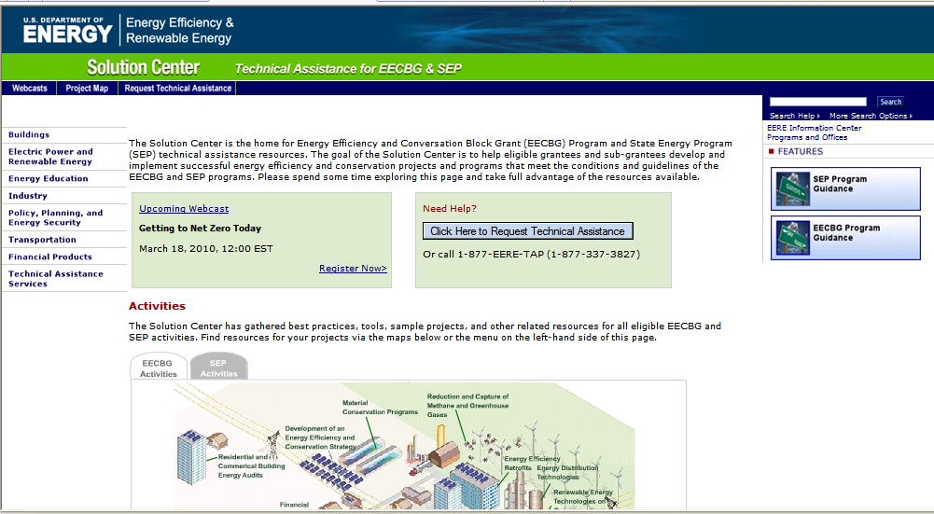
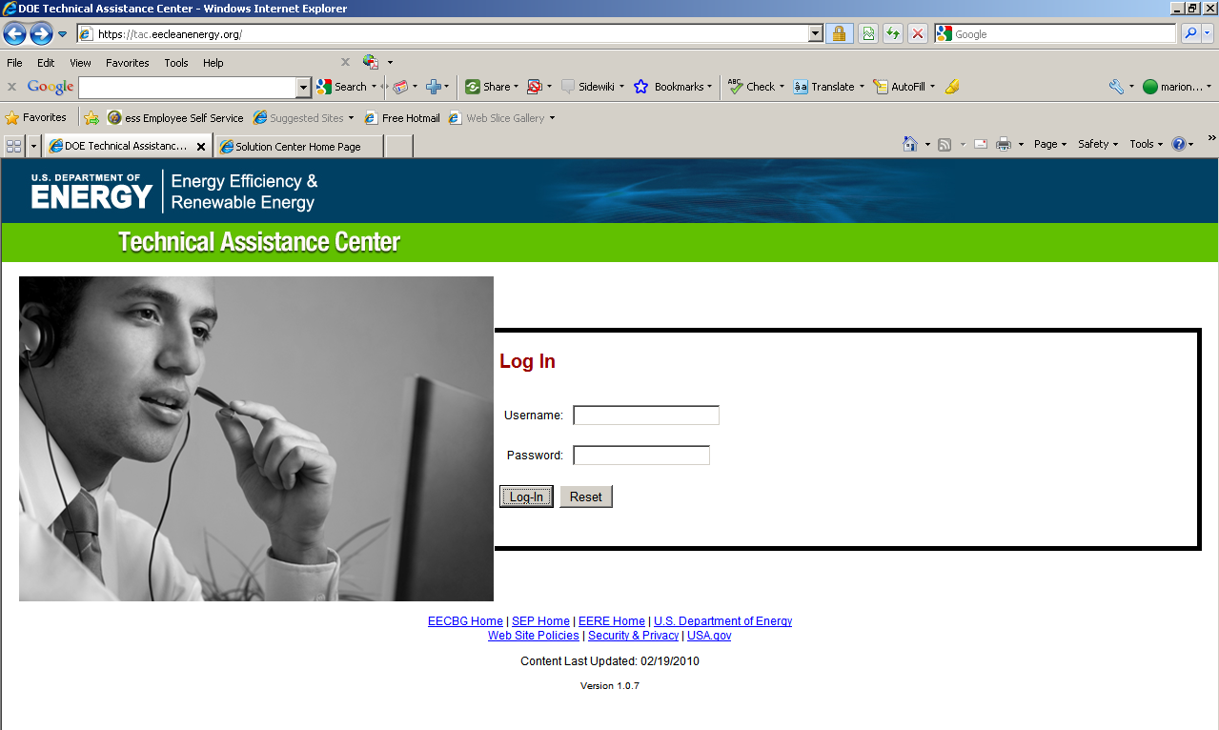
Accessing TAP Resources
We encourage you to:
1) Explore our online resources via the Solution Center
2) Submit a request via the Technical Assistance Center
3) Ask questions via our call center at 1-877-337-3827 or email us at solutioncenter@ee.doe.gov
Notes:
Maybe offer examples of how we’ve already provided specific assistance; e.g., templates of documents for contractor participation agreements and the like, matrix for grading RFP responses, how to identify qualified contractors, typical retrofit opportunities, etc.

Slide 45
Upcoming Webinars
Please join us again:
Title: Taking Advantage of Qualified Energy Conservation Bonds (QECBs)
Host: Mark Zimring, Lawrence Berkley National Laboratory
Date: September 22, 2010
Time: 3:00 – 4:30 EDT
Title: Energy Saving Performance Contracting (ESPC) Basics
Host: Meg Giuliano, ICF International
Date: September 23, 2010
Time: 1:30 – 2:30 EDT
Title: “Green” Codes and Programs
Host: J.C. Martel, Southwest Energy Efficiency Alliance
Date: September 24, 2010
Time: 2:00 – 3:00 EDT
Title: Designing Effective Renewables Programs
Host: Cheryl Jenkins, Vermont Energy Investment Corporation
Date: September 28, 2010
Time: 2:00 – 3:00 EDT
Title: Driving Demand for Home Energy Improvements: Lessons from the Field
Host: Sarah Busche, National Renewable Energy Laboratory
Date: September 29, 2010
Time: 3:00 – 4:15 EDT
Title: Residential Building Audits and Retrofits
Host: Casey Murphy, ICF International
Date: September 1, 2010
Time: 1:00 – 2:00 EDT
Title: Low-to-No Cost Strategy for Energy Efficiency in Public Buildings
Host: Carolyn Sarno, Northeast Energy Efficiency Partnerships
Date: September 14, 2010
Time: 2:00 – 3:00 EDT
Title: Stretch/Reach Codes
Host: Isaac Elnecave, Midwest Energy Efficiency Alliance
Date: September 15, 2010
Time: 2:00 – 3:00 EDT
Title: Loan Loss Reserves: Lessons from the Field
Host: Merrian Fuller, Lawrence Berkley National Laboratory
Date: September 20, 2010
Time: 2:00 – 3:15 EDT
For the most up-to-date information and registration links, please visit the Solution Center webcast page at www.wip.energy.gov/solutioncenter/webcasts

Slide 46
Questions & Comments
Richard Faesy
Energy Futures Group
rfaesy@energyfuturesgroup.com
Phone: 802-482-5001 ex. 2
Cell: 802-355-9153

Slide 47
Questions?
CONTACTS
VEIC: Dan Quinlan, dquinlan@veic.org, 802-488-7677 (Team 4 Lead)
MEEA: Wendy Jaehn, wjaehn@mwalliance.org, 312-784-7272
NEEP: Ed Londergan, elondergan@neep.org, 781-860-9177
NEEA: Dave Kresta, dkresta@nwalliance.org, 503-827-8416
SWEEP: Curtis Framel, cframel@swenergy.org, 303-447-0078
SEEA: Jolyn Newton, jolyn@seealliance.org, 615-612-9592
ACEEE: Eric Mackres, emackres@aceee.org, 202-507-4038
NRDC: Lara Ettenson, lettenson@nrdc.org, 415-875-6100
EFG: Richard Faesy, rfaesy@energyfuturesgroup.com, 802-482-5001

