Slide 1
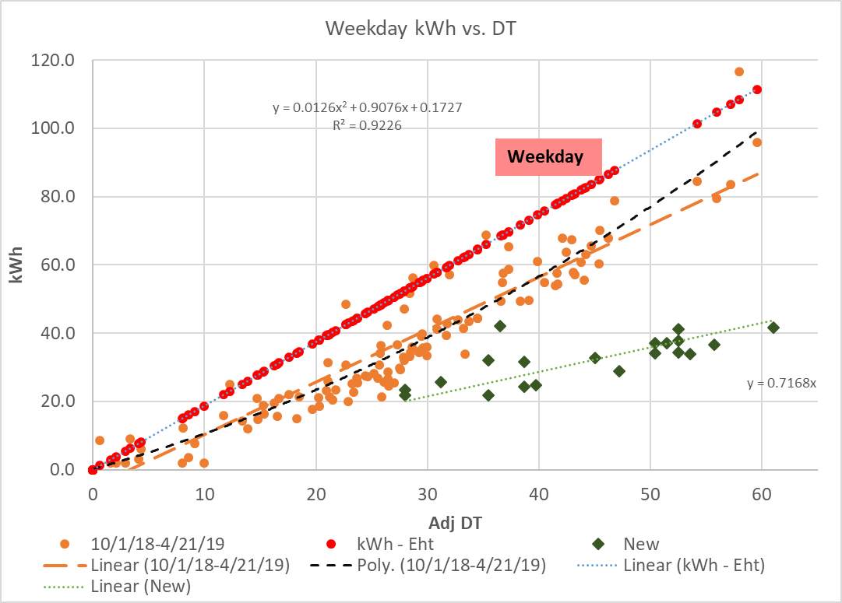
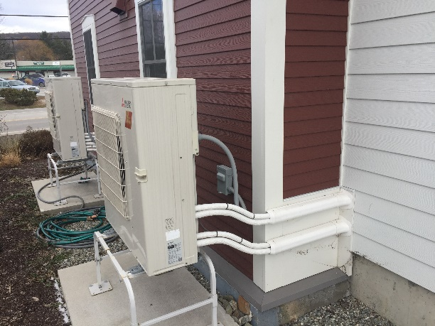
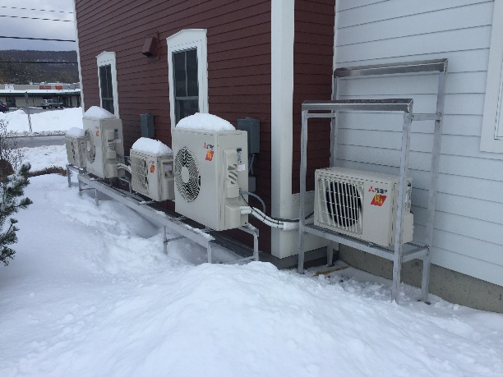
EFG Office Building Heat Pump Swap-Out
Before:
Heat load (resistance heat)
ASHP 1st winter
After:
ASHP - New
New installs as of 2/8/19 – 3/7/19

